Slide 1
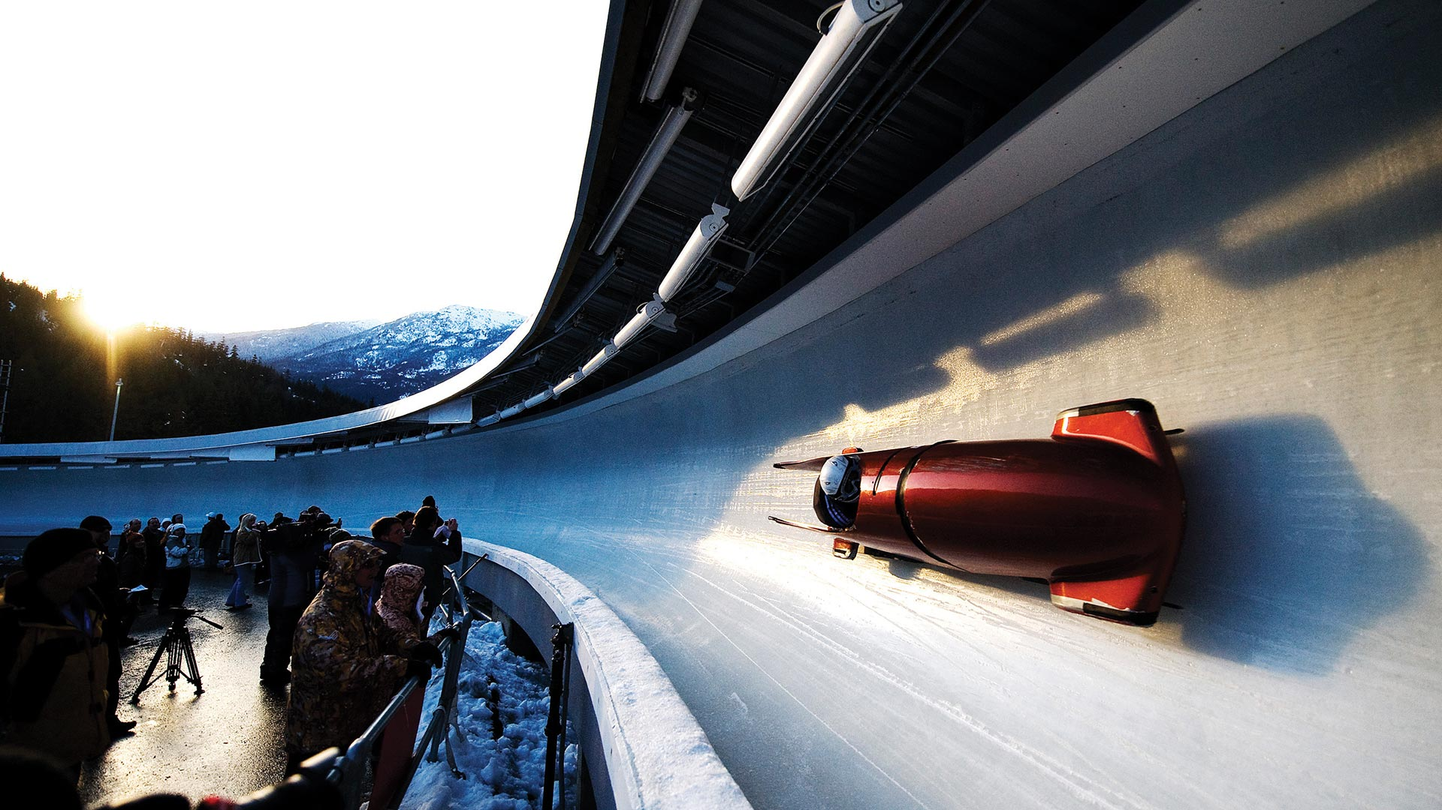
Speed and Control
An experience report
Jonathan Smart @jonsmart DOES LDN June 2017

Slide 2
Context
Notes:
First, some context

Slide 3
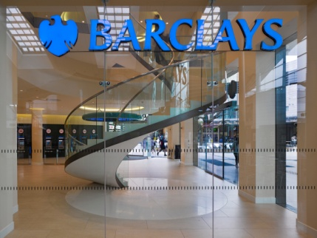
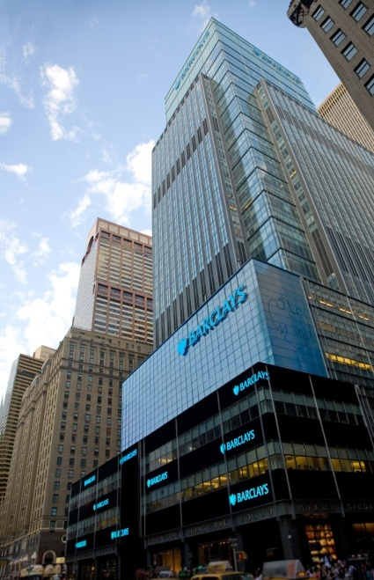
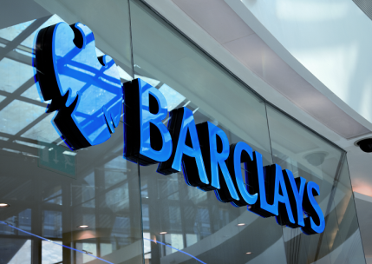
Barclays moves, lends, invests and protects money for customers and clients worldwide
327 years old
Founded 1690
120,000 employees in 40 countries
48m customers
30% of the annual UK GDP processed every day, ~£600 billion per day
Meet a financial need for almost 50% of adults in the UK
Operating in the most regulated industry
Notes:
Barclays is a transatlantic consumer, corporate and investment bank offering products and services across personal, corporate and investment banking, credit cards and wealth management, with a strong presence in our two home markets of the UK and the US.
With over 327 years of history and expertise in banking, Barclays operates in over 40 countries and employs approximately 120,000 people. Barclays moves, lends, invests and protects money for customers and clients worldwide.
12 retail banking digital transactions every second
£1 in every £3 in the UK was spent through Barclaycard
Meets a financial need for almost 50% of adults in the UK

Slide 4
Video
Notes:
Video clip

Slide 5


Notes:
First I’m going to share some Lessons Learnt, the things I would tell myself at the beginning of 2015 if I could.
Then I’m going to share what we’re doing around Speed and Control in the most regulated industry.
This symbol denotes a lesson we have learnt, a challenge, learning through failing

Slide 6
Better Value Faster
Safer Happier
From Productivity to ‘Valuetivity’

Slide 7
Whole Enterprise Agility
The speed and effectiveness with which an organisation can generate new insights, adapt and respond to them*
Purpose driven, self managing, Shape Shifters, Thixotropic
* credit: Dan North

Slide 8
It’s easier to
act your way to a new way of thinking
rather than
think your way to a new way of acting
Old Model
Change thinking to change behaviour
WHAT
WE DO
VALUES AND ATTITUDES
CULTURE
New Model
Change behaviour to change thinking
John Shook’s Change Model
Notes:
Change the system

Slide 9
Bold
Smart
Patient
Kevin Meyer, 2008
Notes:
Kanban philosophy may work in a local optimisation, it doesn’t work when part of a bigger system which need to pivot.
Need bold steps. In experience this is where I’ve seen it work best. Pivot to product, feature teams.
Be willing to change the system of work.

Slide 10
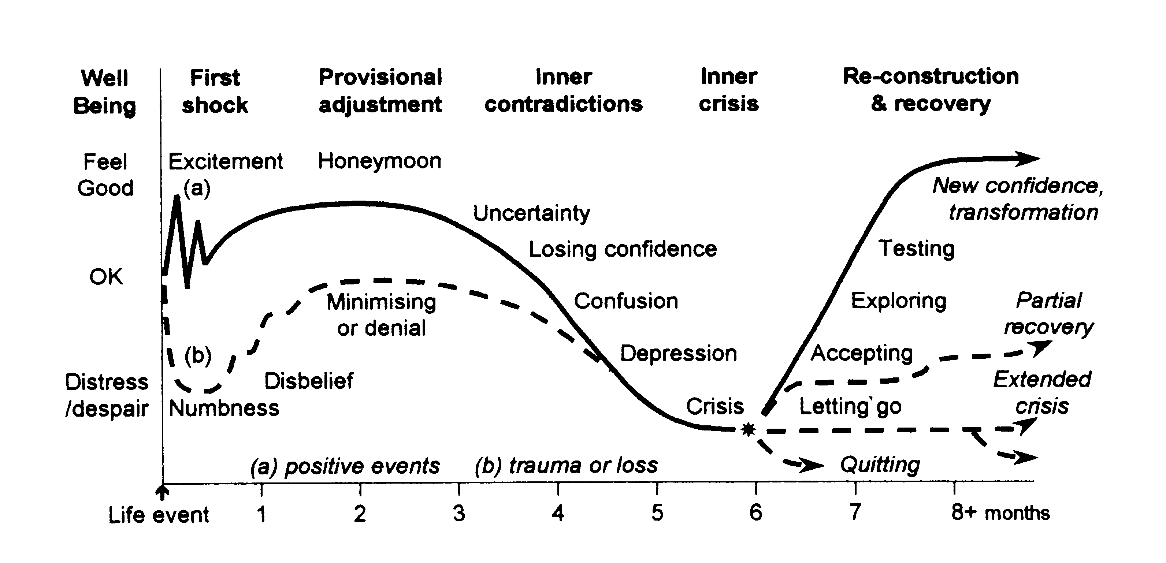

Use the force Luke
Kubler Ross Curve

Slide 11
Speed & Control
Notes:
I’m now going to talk about Speed and Control. Can appear to be a dichotomy.
Agile not fragile.

Slide 12
Lean Control
(do the thing right)
Lean Portfolio Management
(do the right thing)

Slide 13
Lean Control

Slide 14
Cows in the Meadow Game
Team 1: Vision, early & often Control SME interaction
Team 2: Role specialisation, end of lifecycle Control SME

Slide 15
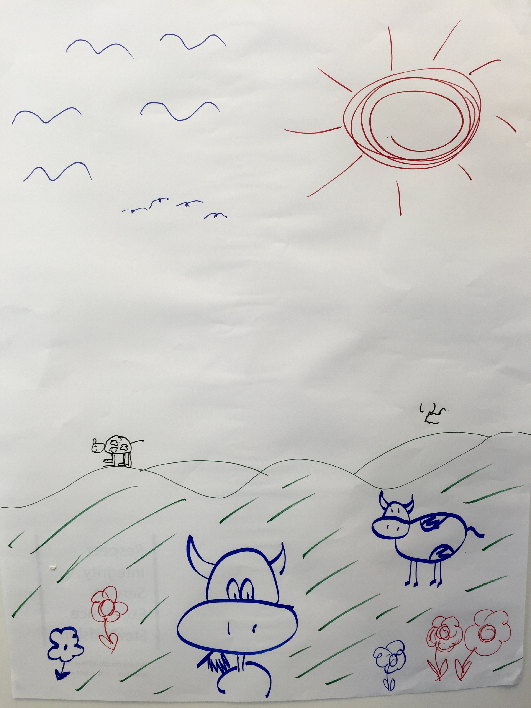
Team 1

Slide 16
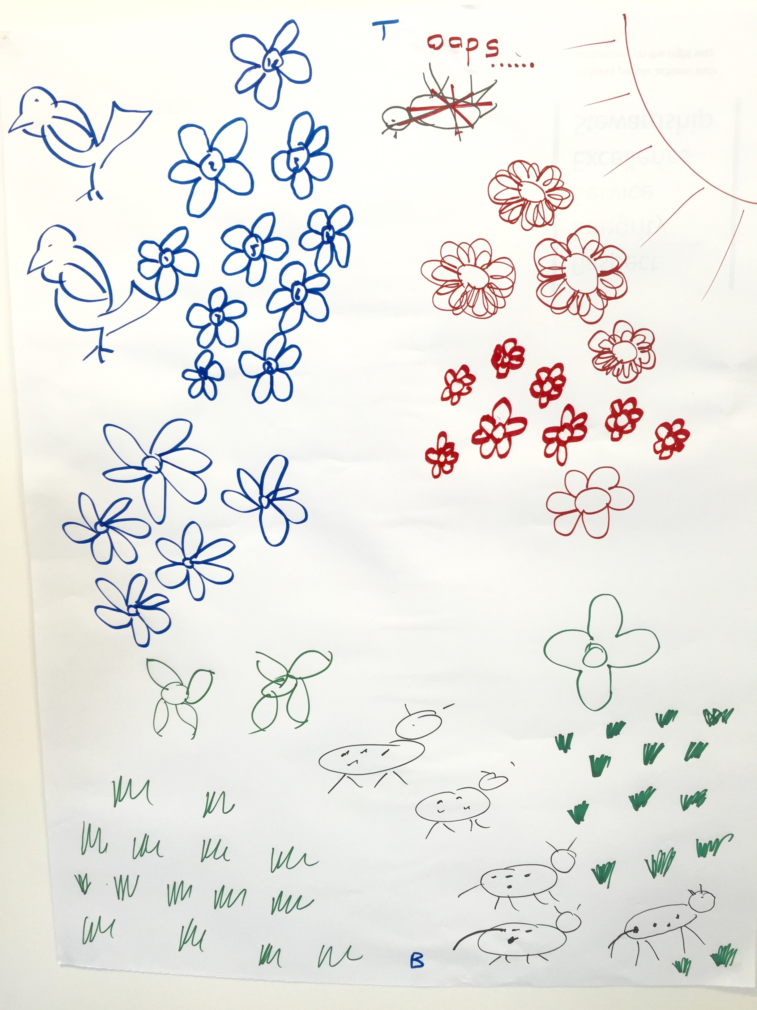
Team 2

Slide 18
Control Tribes
Early & Often Interaction
Long lived alignment to Value Stream

Slide 19
Lean Control Tool
Risk context sensitive
Long lived Products & Business Outcomes
Menu of risk stories
Conversation with Control SME
Engagement Health Indicator
Don’t just ‘automate all the things’

Slide 20
Lean Portfolio Management
Notes:
Front end of the pipeline also needs speed and control. Are teams working on the right things? Are the right things getting to the teams quickly?

Slide 21

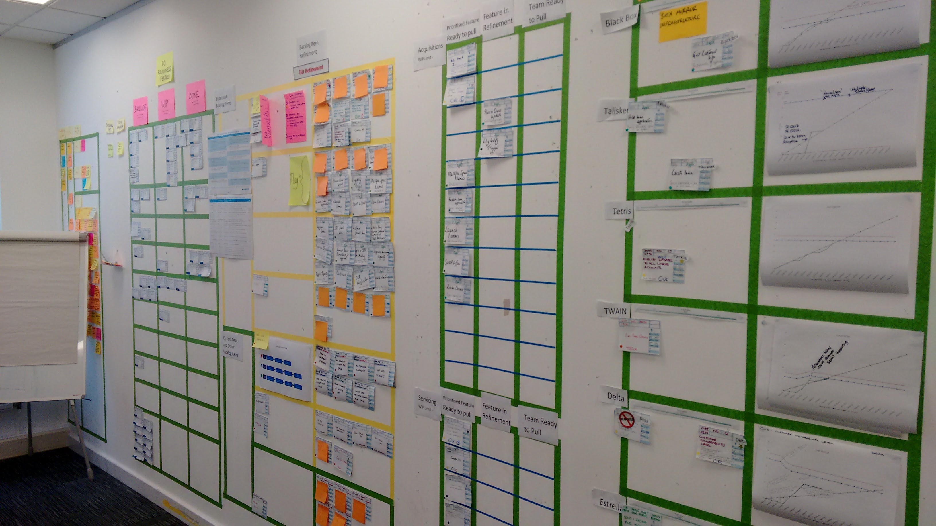
Hypothesis Driven Investment
Business Outcomes
Quarterly Rolling Wave
Incremental build of business case
Performance Walls
We believe <this capability>
Will result in <this outcome>
We will have confidence to proceed when
<we see a measurable signal>

Slide 22
Foward Path
Continue to enhance end to end system of work
Lean Change
Deep Agile Exemplars
Whole Enterprise Agility
DevOps Culture
Technical Excellence

Slide 23
Thank you

